Slide 1
LIFE BETWEEN PASTORS
The Realities of and Ministry to
A Church in Transition
Dr. Rich Brown, National Director of Pastor and Regional Relationships
Interim Pastor Ministries
Dave
Notes:
“Strategic” – beyond pulpit supply
“Fulfilling” - Paul Edwards “more alive”; use of experience and maturity
My story of interim pastoring

Slide 2
IT IS INEVITABLE…
At Some Point All Pastors Will Move On
At Some Point All Pastors Will Move On
Notes:
(like Scott Peck’s opening line in Road Less Traveled - “Life is hard.”)
VanderBloemen – Next – all pastorates are interim pastorates
Cheyney and Sells in their book, Life After Death cite statistics that indicate that fifteen hundred pastors in America left the ministry each month in 2017 because of burnout, conflict or moral failure,

Slide 3
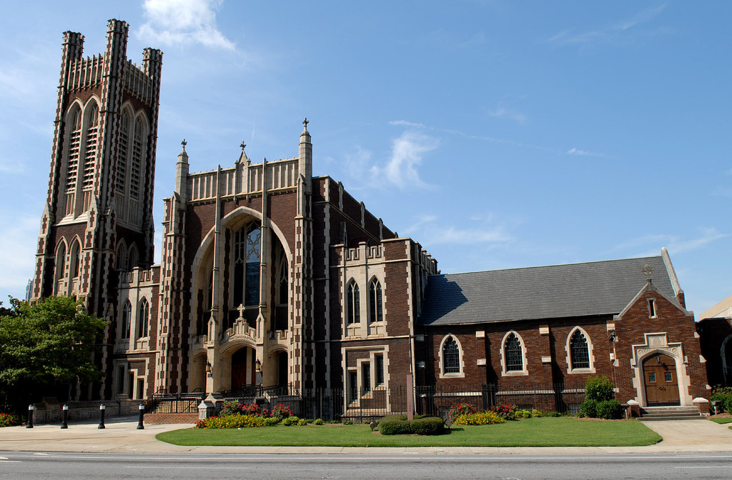
Notes:
300,000 churches in America; estimated that as many as 10% are in transition annually
Majority of those churches in transition are established and/or traditional churches
75% - 80% are plateaued or declining
Need revitalization (new mission, vision)
Questions to ask to see if your church needs to make significant changes to thrive:
Do you have an average public worship attendance of more than 50?
Do you have more than 25 giving units?
Do you have more than one leader for every ten people?
Do your existing church members have an average tenure of less than ten years?
Does your church match its community ethnically and socioeconomically?
(“No” answers indicate need for significant change

Slide 4
RETIRE
Notes:
Age of pastors is getting older – used to be 44 now 54

Slide 5
CALLED TO NEW MINISTRY
Notes:
Often too soon – average 4-6 years (which is why I wrote “Extended Stays”

Slide 6
RESIGN
Bnt
Notes:
Direction: “The church will not follow my lead.”
Little Fruit/Shattered Dreams: "I can't see any progress.”
Burnout: "I need rest and refreshment.”
Critics: ”I am tired of the criticism
Financial Struggles: “I am not able to provide well enough for my family”
Family Issues: “Our family is unhappy here.”
Discouragement: “I no longer enjoy this church. I need a new setting.”

Slide 7
TERMINATED
Notes:
Cheyney and Sells in their book, Life After Death cite statistics that indicate in 2017 thirteen hundred pastors were terminated by the local church each month and 75% of churches during last five years experienced conflict.
One-third of all pastors (34 percent) serve congregations who either fired the previous minister or actively forced his or her resignation.
Ten percent of dismissed predecessors left pastoral ministry.
Nearly one-fourth (23 percent) of all current pastors have been forced out at some point in their ministry.
Forced exits – more in 35-49 age group

Slide 8
REACTIONS TO PASTOR LEAVING
Power Vacuum
Grief
Joy
Fear/ Uncertainty
Questioning
Notes:
Regardless of why pastor left
Grief – by those who love the pastor
Joy – Some are glad he left or felt it was time for a change
Questioning – Why is he leaving? Doesn’t he like us anymore? Was he driven out?
Uncertainty – What’s going to happen? Who will preach and lead? Do we have a future?
A power vacuum can develop. There may be power struggles.
Some cause happiness wherever they go; others whenever they go.
DISCUSS: any other reactions?
Mistake #10 Failure to be honest about congregational problems.
Results: Applicant may learn of problems through other sources. He may decide not to come because of lack of honesty or forthrightness of the PNC. If he does come, he may become quickly disillusioned for the same reason. He may not have the skills to handle the specific problem.
Mistake #19 Not allowing enough grieving time between pastors.
Results: Congregation fails to or is slow to bond with new pastor. New pastor frequently compared with previous one, sometimes not objectively. Anger comes out at new pastor that is transferred from former pastor.
This is one reason why interim pastoring is fulfilling. The “pastor” in us helps
The church deal with this.

Slide 9
NORMAL FIRST RESPONSES
Name a Search Committee
Get lots of names
Call Our New Senior Pastor
Speed is Important
Notes:
What are the first things in the road ahead for the church?
What will it mean for the church to go down that road?
Who will lead the church down that road?

Slide 10
DANGERS IN THE INTERIM
Moving Too Fast
Overemphasis on Preaching
Succumbing to a Preaching Beauty Contest Mentality
Preaching is only one of many important considerations
Notes:
21 Mistakes a Pastoral Search Committee Makes

Slide 11
DANGERS IN THE INTERIM
Lobbying for Personal Favorites
Short-circuits the Process
Politicizes and Polarizes
Basing Your Choice on Stylistic Preferences
Different Folk Prefer Different Kinds of Pastors
Notes:
Discussion

Slide 12
THE INTERIM PERIOD
What Is It?
The period of time between your last Pastor’s departure and your new pastor’s arrival
How Long Does It Last?
Typically anywhere from 9 to 30 months
Notes:
One month for every year previous was. there

Slide 13
FACTORS IMPACTING LENGTH OF INTERIM
General Health of the Church
Relational Health of the Church
Recent levels of conflict
Long-term broken relationships
Buried History
Simmering Issues (staff, worship and music; fallout from change; governance, etc.)
Notes:
IPM – Three levels of interims – Intentionality Grid

Slide 14
CHURCH ROLES IN THE INTERIM
The Board
Partner with Staff to provide leadership
Chart the Interim Course
Actively seeking and working with an Intentional Interim Pastor
Pastoral and Church Staff
Partner with Board to provide leadership
Guide the continuing ministries of the church
Notes:
Discussion

Slide 15
CHURCH ROLES IN THE INTERIM
The Congregation
Be regular in attendance
Be faithful in service
Be diligent in prayer
Be generous in giving
Be patient in waiting
It is more important to make the right choice than to make a fast choice!
Notes:
Discussion

Slide 16
STAFFING FAQ’S
How Do We Staff for the Interim?
Who Will Preach?
Who Fulfills the Senior Pastor’s Remaining Duties?
What Options Do We Have?
Notes:
Discussion

Slide 17
TRANSITIONAL OPTIONS
Notes:
All of this work in the transition period takes time
What a church chooses as its transition option will have an important impact and sometimes unanticipated effect on the church’s next season of ministry

Slide 18
TRANSITIONAL OPTIONS
Internal Candidate: Mentor an Associate to be the Successor
Notes:
MENTORED
20% of Churches Have This Potential (Multi-staffed)
Discuss: Pros and Cons

Slide 19
POLICY FOR INTERNAL CANDIDATES
Before the senior pastor resigns, the church board prepares the church for potential internal candidates by establishing a policy that any individual who “puts his name in the hat” for the position pledges himself, before he is officially considered, to leaving the congregation, quickly and quietly, if he is not selected for the position.
It will never work for him – except in the rarest of circumstances – to remain in the church after his rejected candidacy. It’s like trying to continue in your office job, as if nothing has happened, after your failed romance with the person in the next cubicle.
Those who have seen these scenarios play out repeatedly say that it’s just a matter of time before the rejected internal candidate will leave the congregation. The sooner he leaves the scene, the better it is for everyone involved.
Credits: Brian Thorstad, author of Redevelopment
Notes:
Put in writing
Crosspointe Church (Redding) story – didn’t have policy until after the fact; assistant and family hurt, left church without farewell.

Slide 20
TRANSITIONAL OPTIONS
2. Search Externally and select a New Pastor Before Pastor Finishes
Notes:
Usually not financially feasible
Can be awkward for existing pastor
(Rick Harpel – Yakima – Westside Baptist Church). Team of three; church looked for replacement of Rick while he was still there
DISCUSS: pros and cons

Slide 21
TRANSITIONAL OPTIONS
3. Have Staff Preach as Church Searches
Notes:
DISCUSS: pros and cons
SHCC tried for a year
Staff overloaded – takes time away from their own responsibilities
A staff can begin to lobby for the lead pastor position
Church can choose sides

Slide 22
TRANSITIONAL OPTIONS
4. Hire Pulpit Supply as Church Searches
Notes:
Good idea? Not good idea?
SHCC tried
Discontinuity
Issues of planning
Important issues in the church do not get addressed

Slide 23
TRANSITIONAL OPTIONS
5. Call a Traditional Interim Pastor
Notes:
If there are not issues to be addressed (staffing blunders, conflict, relationships in the church, moral failure, church documents)
(Resource: Aftermath by Rick Foster)

Slide 24
TRANSITIONAL OPTIONS
6. Call an Intentional Interim Pastor
Notes:
“intentional” – tasks to fulfill in the interim
“interventionist” – serious issues to be addressed
More than a weekend pulpit supply

Slide 25
INTERIM TYPES
INTERIM PREACHER INTERIM PASTOR INTENTIONAL INTERIM PASTOR
PART-TIME PART-TIME PART OR FULL-TIME
FILLS THE PULPIT FILLS THE PULPIT FILLS THE PULPIT
LIMITED OVERSEES NORMAL PASTORAL CARE PASTORAL CARE
LIMITED FULL PASTORAL
LEADERSHIP INTENTIONAL
(STAFF/BOARD) LEADERSHIP
(INTERIM ISSUES)
Notes:
Intentional Interim Pastor:
Takes unique mix of gifts and experience
Brings the “eyes” of experienced outsider
Possesses skills necessary to address issues
Will maximize the impact of the interim period
Will prepare the church for your next Senior pastor – if you let him!

Slide 26
INTENTIONAL INTERIM PASTOR
Can create an atmosphere where renewal and healthy change are expected, potentially realized
Can provide an opportunity to work on specific tasks
Can put the focus on overall congregational health, preventing a premature pastoral search
Can allow a congregation to embrace a transitional vision with clear goals and directed action
Can give a congregation the opportunity to clean house and re-establish what’s really important

Slide 27
Times of pastoral transition are windows of opportunity. For a congregation that seizes the opportunity, it can be a transformational turning point toward greater health and mission effectiveness. Welcoming a new senior pastor to a healthy, functioning, spiritually renewed congregation is a goal worth pursuing!
From Between Pastors by Cam Taylor
Director of Transitional Leadership Ministries (of Outreach Canada)
Notes:
Opportunity for departing pastor and for the remaining church

Slide 28
WHAT SHOULD HAPPEN IN THE INTERIM?
Gain Perspective
On the church’s past
On a current and realistic view of the Church
On a renewed understanding of the Community
Notes:
Demographic study
Church survey (Ministry Insight Tool)

Slide 29
WHAT SHOULD HAPPEN IN THE INTERIM?
Prepare for New Long-term Senior Pastor
Adapt to “Different”
Clarify the congregation’s vision of the church’s future
Deal with unresolved past issues so the new Pastor can focus on the future
Search for, find and call your new Senior Pastor
Notes:
Discussion

Slide 30
INTERIM AGENDA
Assess and Evaluate
Congregational Survey
Focus Group Listening Process
Evaluation
Report
Adopt a Process to Act on the Assessment Findings
Notes:
IPM - ten tools for church assessment

Slide 31
INTERIM AGENDA
Address Issues
Conflict; Broken and Strained Relationships; Simmering Issues Unresolved Issues
Old Pattern
Hide, deny, bury and disguise problems
Let the new pastor deal with them when necessary
Notes:
Issues of staff (SHCC - Worship Leader
NCR - 4 of 8 transitioned out

Slide 32
INTERIM AGENDA
Focus: Clarify the Church’s Mission, Vision and Values
Old Pattern
Get a new pastor as soon as possible
He will communicate his vision for the church
We will follow
Notes:
Our Mission: What task has God called us to?
Our Vision: Where are we headed?
Our Values: Why do we do what we do? What is important to us?

Slide 33
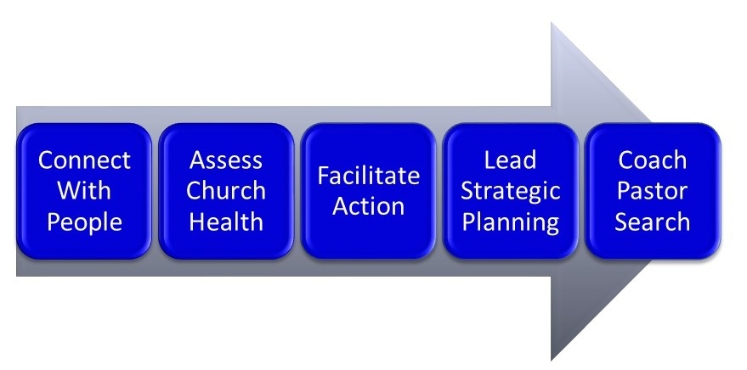
IPM’s 5 Stage Process

Slide 34
Partner With Us to Support and Strengthen Churches in Pastoral Transition
800-501-7117 interimpastors.com

Slide 35
LIFE BETWEEN PASTORS
The Realities of and Ministry to
A Church in Transition
Dr. Rich Brown, National Director of Pastor and Regional Relationships
Interim Pastor Ministries
Dave
Notes:
“Strategic” – beyond pulpit supply
“Fulfilling” - Paul Edwards “more alive”; use of experience and maturity
My story of interim pastoring

