Slide 1
Loving and Leading People Who Don’t Behave Like You
Dr. Rich Brown
Interim Pastor Ministries
National Director of Pastor and Regional Relationships

Slide 5
TELLERS
ASKERS

Slide 6
TASKS
RELATIONSHIPS

Slide 7
TELLERS
ASKERS
TASKS
RELATIONSHIPS

Slide 8
TELLERS
ASKERS
TASKS
ANALYTICALS
DRIVERS
AMIABLES
EXPRESSIVES
RELATIONSHIPS

Slide 9
TELLERS
ASKERS
TASKS
DRIVERS
Control
Achievement
Challenge/Win
RELATIONSHIPS

Slide 10
DRIVERS are admired for being...
Strong-willed
Productive
Decisive
Practical
Visionary
Optimistic
Born Leader
Self-sufficient
Able to oversee change
Correcting wrongs
Not easily discouraged
Independent
Confident

Slide 11
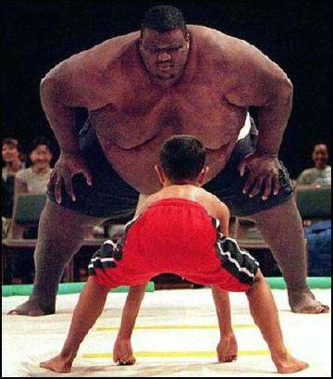
TELLERS
ASKERS
TASKS
DRIVERS
RELATIONSHIPS

Slide 12
TELLERS
ASKERS
TASKS
EXPRESSIVES
RELATIONSHIPS

Slide 13
TELLERS
ASKERS
TASKS
Interaction
Recognition
Influence
EXPRESSIVES
RELATIONSHIPS

Slide 14
EXPRESSIVES are admired for being…
A great personality
Warm and friendly
The life of party
Compassionate
Demonstrative
Cheerful
Sincere
Generous
A good story teller
A people person

Slide 15
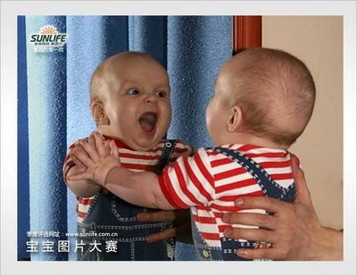
TELLERS
ASKERS
TASKS
EXPRESSIVES
RELATIONSHIPS

Slide 16
TELLERS
ASKERS
TASKS
ANALYTICALS
RELATIONSHIPS

Slide 17
TELLERS
ASKERS
TASKS
ANALYTICALS
Evidence
Accuracy
Quality
RELATIONSHIPS

Slide 18
ANALYTICALS are admired for being…
Thinkers
Self-disciplined
Serious
Accurate
Sensitive
Competent
Careful
Systematic
Even-tempered
Creative

Slide 19
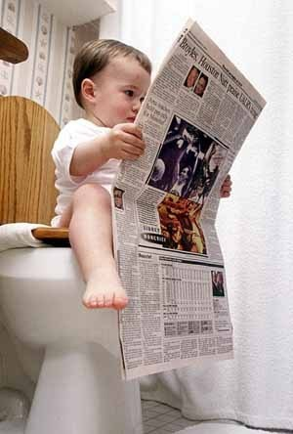
TELLERS
ASKERS
TASKS
ANALYTICALS
RELATIONSHIPS

Slide 20
TELLERS
ASKERS
TASKS
AMIABLES
RELATIONSHIPS

Slide 21
TELLERS
ASKERS
TASKS
Loyalty
Security
Approval
AMIABLES
RELATIONSHIPS

Slide 22
AMIABLES are admired for being
Likeable
Diplomatic
Efficient
Organized
Dependable
Conservative
Loyal
Easy-going, calm
Patient
Quiet but witty
Sympathetic
Trustworthy
Team-player
Consistent

Slide 23
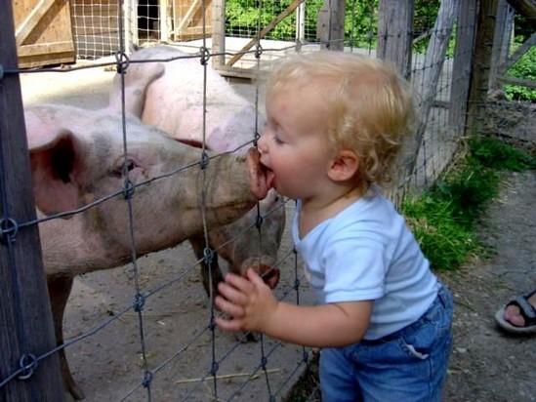
TELLERS
ASKERS
TASKS
ANALYTICALS
DRIVERS
AMIABLES
EXPRESSIVES
RELATIONSHIPS

Slide 24
TELLERS
ASKERS
TASKS
ANALYTICALS
DRIVERS
Evidence
Accuracy
Quality
Control
Achievement
Challenge/Win
Loyalty
Security
Approval
Interaction
Recognition
Influence
AMIABLES
EXPRESSIVES
RELATIONSHIPS

Slide 25
Strong Willed Independent Practical Decisive Efficient
ANALYTICALS
DRIVERS
Industrious
Persistent
Serious
Exacting
Orderly
AMIABLES
EXPRESSIVES
Supportive Dependable Willing Respectful Agreeable
Friendly
Ambitious
Dramatic
Enthusiastic
Stimulating

Slide 26
Pushy Severe Tough Dominating Harsh
ANALYTICALS
DRIVERS
Critical
Indecisive
Stuffy
Picky
Moralistic
AMIABLES
EXPRESSIVES
Conforming Unsure Ingratiating Dependent Awkward
Manipulative
Excitable
Undisciplined
Reacting
Egotistical

Slide 27
P P
R R
I O
O B
R L
I E
T M
Y S
P P
R R
I O
O B
R L
I E
T M
Y S
ANALYTICALS
DRIVERS
AMIABLES
EXPRESSIVES

Slide 28
PACE PROBLEMS
ANALYTICALS
DRIVERS
AMIABLES
EXPRESSIVES
PACE PROBLEMS

Slide 29
PACE PROBLEMS
P P
R R
I O
O B
R L
I E
T M
Y S
P P
R R
I O
O B
R L
I E
T M
Y S
ANALYTICALS
DRIVERS
AMIABLES
EXPRESSIVES
PACE PROBLEMS

Slide 30
PACE PROBLEMS
P P
R R
I O
O B
R L
I E
T M
Y S
P P
R R
I O
O B
R L
I E
T M
Y S
ANALYTICALS
DRIVERS
AMIABLES
EXPRESSIVES
PACE PROBLEMS

Slide 31
TELLERS
ASKERS
TASKS
ANALYTICALS
DRIVERS
AMIABLES
EXPRESSIVES
RELATIONSHIPS

Slide 32
DRIVERS love it when you
Are brief, direct, to the point
Ask “what” not “how” questions
Focus on results
Give them the “bottom line”
Highlight benefits of your ideas
Agree with facts not emotions
Discuss problems in light of results

Slide 33
EXPRESSIVES love it when you
Give them opportunity to talk and socialize
Share your ideas and experiences
Recognize their effort
Show them you accept them and their ideas
Give them chance to motivate/influence others
Explain but don’t dwell on details
Communicate in friendly manner

Slide 34
ANALYTICALS love it when you
Support ideas with accurate information
Are specific when explaining yourself
Are patient, diplomatic, persistent while providing explanations
Agree with facts rather emotions
Allow them space and independence
Tell them expectations and details up front
Give them pros and cons of argument

Slide 35
AMIABLES love it when you
Express genuine interest in them
Give the answers to “how” questions
Clearly define goals, procedures, role
Are patient with them, not pushy or demanding
Give them sincere appreciation
Give them time to adjust to changes
Provide feedback

Slide 36
¹⁷ If the whole body were an eye, where would the sense of hearing be? If the whole body were an ear, where would the sense of smell be?
¹⁸ But in fact God has placed the parts in the body, every one of them, just as he wanted them to be.
¹⁹ If they were all one part, where would the body be?
²⁰ As it is, there are many parts, but one body.
²¹ The eye cannot say to the hand, “I don’t need you!” And the head cannot say to the feet, “I don’t need you!”
1 Corinthians 12:17-21

